Slide 1
Cancer and Epigenetics
From Stem to Cancer
Brian Wiley
Yea Ji Sea
Chris Sohn
Notes:
Good Evening class. Welcome to our presentation tonight on Cancer Stem Cells and Epigenetics presented by myself Brian Wiley, Yea Ji Sea, and Chris Sohn.

Slide 2
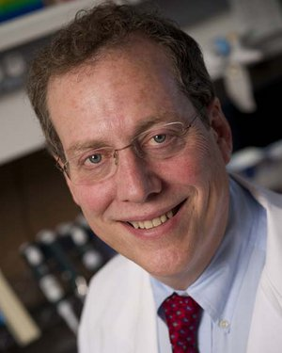

Inspiration
BJW
Researchers at Johns Hopkins : SB Baylin, AP Feinberg
Van Andel Research Institute: PA Jones
“Cancer Stem Cells (CSCs) have shown to be more resistant to anti-tumor treatments than the non-stem cancer cells, suggesting that surviving CSCs could be responsible for tumor relapse after therapy.” (Munoz et al 2012) ¹²
“CSCs are the likely source of resistant cells responsible for disease relapse because cells deprived of self-renewing potential are unable to reconstitute the cancer even if they survive treatment.” (Wainwright & Scaffidi 2017) ¹³
Notes:
As I was reading Chapter 34 at the beginning of the semester, I was really attracted to this cool topic about Cancer Stem Cells and their implications where we see cancer relapse in patients after they have been in remission for some time.
Stephen B. Baylin and Cynthia A. Zahnow of Sydney Kimmel Cancer Center wrote article in 2010 titled “Epigenetic Networks and miRNAs in Stem Cells and Cancer” where they write “Cancers have many properties of embryonic-like cells.” and “increased expression of components of [epigenetic determinants] are a prominent feature of the cancer and embryonic stem cell signatures”. (Baylin and Zanhow 2010) ²⁴
Peter A. Jones and Michael Lübbert wrote a textbook in 2014 titled “Epigenetic Therapy of Cancer: Preclinical Models and Treatment Approaches” where they write (page 57) “Stem cells are characterized by low expression of genes driving lineage differentiation but high expression of genes maintaining self-renewal... [and] studies in Dnmt1-mutant mice have shown that DNA methylation is essential...to protect self-renewal and multipotency in normal as well as leukemic stem cells by suppressing lineage-specific genes.” (Jones and Lübbert 2014) ²⁶
Many other articles declare that CSCs are more resistant to anti-tumour treatments than non-stem cancer cells and this source of resistance is likely responsible for cancer relapse. After looking into some researchers regards stems cells within the Johns Hopkins family we came across this cool paper by Dr. Andrew Feinberg. Chris will go into a little introduction about the topic and then about the paper.

Slide 3
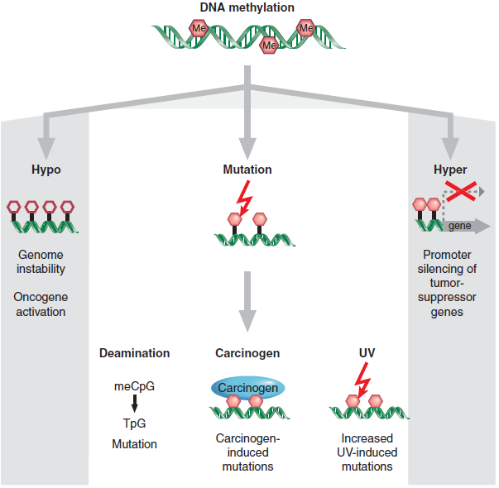
Role of DNA Methylation in Cancer
CS
As described by Baylin and Jones in Ch. 34, the three epigenetic modifications proposed in the diagram will in tandem contribute to cancer.
general hypomethylation of the cancer genome leading to genome instability and aneuploidy
hypermethylation of CpG islands in 5’ regions of tumor suppressor genes
mutagenesis of the methylated cytosines through UV exposure or other environmental factors
Notes:
Before we get into the feinberg paper, ill talk about a bit of background.
The first epigenetic mechanism of cancer is DNA methylation. As described by baylin and jones in our textbook in chapter 34, there are three ways that methylation can contribute to cancer
Hypomethylation, which is a loss of methylation, leading to genome instability and aneuploidy (abnormal # chromosomes)
This loss of methylation may be accompanied by the activation of transcription,
allowing transcription of repeats, transposable elements
(TEs), and oncogenes which could lead to cancer Activation of repeats may predispose the genome of a cell to recombination or may express nearby proto-oncogenes
Hypermethylation of CpG islands in 5’ or promoter regions of tumor suppressor genes will silence these genes contributing to cancer
Mutagenesis of CpGs through UV exposure or other environmental factors

Slide 4
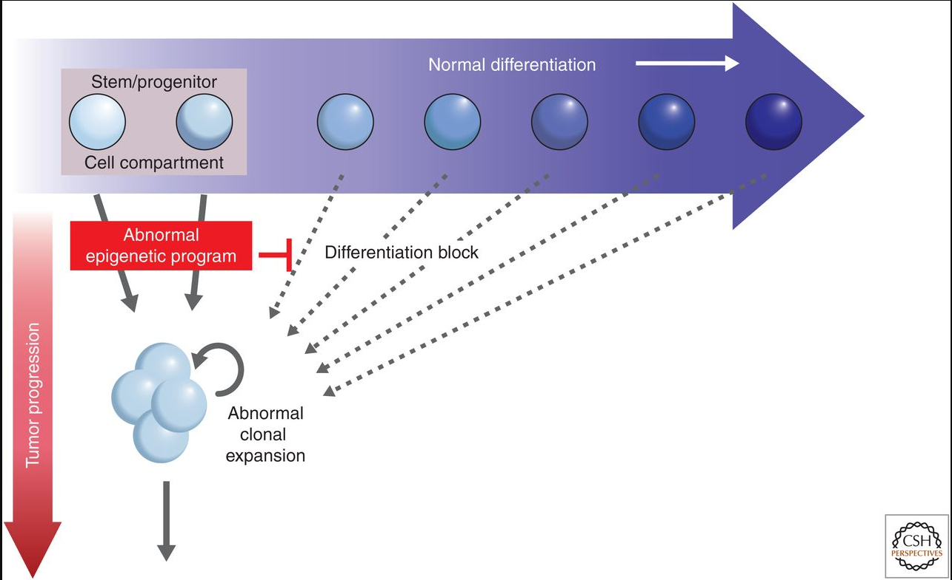
Chapter 34 Intro
CS
Figure from Ch. 34 describing abnormal programming early in differentiation of a progenitor.
If the abnormality isn’t taken under control here, it will lead to tumor progression.
Abnormal clonal expansion
At risk of epigenetic changes
Notes:
In this slide we’ll talk about early abnormal programming in stem cells and progenitor cells.
As we can see in the diagram, the stem cells or progenitor cells can undergo abnormal epigenetic programming early in their differentiation and if this abnormal programming isn’t taken care of quickly, it will delve further into the tumor progression path.
Abnormal clonal expansion - is caused by environmental factors like aging or chronic inflammation and are at risk of epigenetic changes that would lead to tumor progression
These kinds of epigenetic changes are things like gene silencing which is triggered by modifications to chromatin will push stem cells and progenitor cells away from the path of normal differentiation and further down the path of tumor progression.
As we will explain in later slides, the progenitor cells and their ability to undergo abnormal epigenetic programming is what causes tumorigenesis.

Slide 5
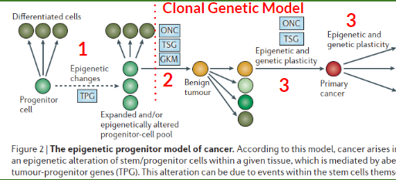
What is the Epigenetic Progenitor Model of Cancer?
CS
Challenges the original view on cancer
Instead dependent on epigenetic changes
Notes:
Now we’ll move onto a big topic in our main paper by Andrew Feinberg
Feinberg proposed the Epigenetic Progenitor Model of Cancer which challenges the original view on cancer - which was initially viewed as a variety of disorders mostly pertaining to abnormal functions of tumor suppressor genes and oncogenes.
This model adds in an extra step before the clonal genetic model of cancer which, according to the diagram, starts at step 2.
Instead, the model starts at step 1 according to the diagram which indicates the epigenetic disruption of stem cells and progenitor cells
Progenitor cells can either differentiate normally or, due to some epigenetic changes or due to tumour progenitor genes indicated by TPG in the diagram, these progenitor cells will expand into an altered progenitor cell pool. To better understand these TPGs, Feinberg talks about them in his paper and refers to their function as to “promote epigenetic disruption and to regulate ‘stemness’ itself, affecting pluripotency and unlimited self-renewal”
Epigenetic changes that could cause the disruption of stem and progenitor cells include global DNA hypermethylation, hypomethylation, and chromatin alterations
To confirm that these are in fact epigenetic changes, in vitro studies have shown that tumors in differentiating leukemia cells show highly reversible properties thus suggesting an epigenetic mechanism
This now leads us to the start of the clonal genetic model which starts with the second step: Initiating mutation in the epigenetically disrupted progenitor cells
Gate keeper mutations indicated by GKM on the diagram themselves are monoclonal, but because of the expanded progenitor cell pool by epigenetic changes or by tumor progenitor genes this leads to an increased risk of cancer. This expanded progenitor cell pool, as indicated by the picture, gives rise to tumorigenesis through oncogenes, or a gatekeeper mutation in tumor suppressor genes.
Third step: Genetic and epigenetic plasticity
This allows for a heightened ability for the tumor propagate with its new phenotype with an epigenetic basis. This will lead to increased tumor evolution .
Brian will now go into further detail about the underlying reasons behind this first step of epigenetic disruption of progenitor cells

Slide 6
1st Step — epigenetic disruption of progenitor cells
BJW
The first step — epigenetic disruption of progenitor cells
The second step — initiating mutation.
The third step — genetic and epigenetic plasticity.
Notes:
The first step of the Epigenetic Progenitor Model of Cancer is the epigenetic disruption of progenitor cells.

Slide 7
1st Step — epigenetic disruption of progenitor cells
BJW
Leads to polyclonal precursor population of progenitor stem cells that are “neoplastic ready”
Disruption of balance between undifferentiated progenitors and lineage committed cells.
Class what could be some reasons?
Notes:
Epigenetic disruption at the stem and progenitor cell levels prepares cells for diseased states. Epigenetic alterations are a main source in tipping balance required for normal stem cell renewal and lineage specific cells needed in the body. This event likely precedes the clonal genetic model for cancer which begins at step 2 of the Epigenetic Progenitor Model of Cancer. What could be some reasons that disrupt the health balance between stems cells and lineage committed cells.

Slide 8
What could be some reasons?
BJWC
DNA methyltransferases and TPGs
Balance of Homeobox (HOX) protein expression regulated by PcG and TrxG.
PcG and TrxG protein themselves. E(Z)/EZH1/2 HKMT (SET domain) for H3K27me3.
Imprinting?
Many other genes such as ...
Is there Evidence?
Notes:
Defects or loss of DNA methyltransferases and the effect with respect to what is known as tumour-progenitor genes mentioned in the progenitor model.
Factors that disrupt the balance of Homeobox (HOX) proteins regulated by PcG and Trithorax groups.
Upregulation or downregulation of PcG and Trithorax protein themselves. Specifically E(Z)/EZH1/2 the methyltransferase (SET domain) for H3K27me3.
Many other genes such as Sox2, Transcription Factors, Homeobox protein Meis1, IDH, Cell Cycle genes p16ink4a, c-Myc, Immunoglobulin genes such as IgH, …
The paper we chose to study by Feinberg was nice enough to provide 5 specific lines of evidence that prove that epigenetic disruption in stem and progenitor cells which Yea Ji will devel in. Just as for foreclose, this is the most exciting and most important part of the paper. No pressure Yea Ji (Brian laughs) :)

Slide 9
Five lines of evidence
YS
Five lines of evidence suggesting evidence of an epigenetically disrupted progenitor cells (Feinberg et al., 2006)
Reversible tumor growth properties
All tumors show global methylation changes and even normal (non-tumour) tissue show same or similar methylation status.
Melanoma nucleus can give rise to a normal mouse showing reprogramming potential
Neoplastic cells can only be maintained by cells with stem cell properties
Loss of imprinting can lead increase in progenitor cell population
Notes:
In-vitro studies have been able to show reversible tumour growth properties. One example which Brian will speak about at the end in the Motivational part is leukemic stem cells (LSCs). The study showed that tumour cells can be epigenetically reprogrammed by inducing differentiation. A link to the paper cited by Feinberg is given.
All tumors show global methylation changes! Both DNA methylation and genetic mutation in tumour are clonally inherited through cell replication. Feinberg indicates that if genetic mutation was the initiating cause then the “global DNA hypomethylation would have to occur universally” (Feinberg et al. 2006) ¹ at the same time as the genetic mutation responsible for the primary cancer. He indicates this is very unlikely. How can millions of CpG be demethylated at the same time as 1 genetic mutation. Further proof here is indicated that normal tissue shows the same or similar global methylation pattern so the DNA methylation changes must occur first and then within any of those replicating cells a subset have genetic mutation causing cancer and the rest of the cells with the same epigenetic marks without the genetic mutation are “normal” non-tumour tissue. We could just drop the mic right here as this is extremely solid proof but there’s more!
In a two-step cloning process, a tumorigenic ESC lines were derived from melanoma nucleus somatic nuclear cell transfer and implanted into tetraploid blastocysts so that the tumorigenic ESCs were exclusive in giving rise to the embryo. These stem cells derived from melanoma nucleus gave rise to entire mouse and “almost all all phenotypic properties of cancer were reversed” albeit these mice had increased melanoma incidence which indicates the tumors are not entirely epigenetic.
CD113+ and CD113- brain tumour cells, where CD113+ is a cell surface marker for self-renewal Neuronal Stem Cells (NSCs) were xenografted into 6-8 week old mice in the frontal cortex. As little at 100 CD113+ cells were able to initiate brain tumors in the mice that received CD113+ xenografts but even 10⁵ CD113- brain tumour cells were not proving stemness characteristics are required to induce tumorigenesis.
Loss of Imprinting - Biallelic expression of Igf2 (Instead of paternal IGF2 and maternal H19nc) lead to shift in balance toward increased ratio progenitor to differentiated cells.

Slide 10
Five lines of evidence 1
YS
Five lines of evidence suggesting evidence of an epigenetically disrupted progenitor cells (Feinberg et al., 2006)
Reversible tumor growth properties
study was done in leukemic cells.
Explained in detail in Brian’s motivational part
Notes:
In vitro studies with leukemic cells, they found that these tumor traits could be reversed. Specific
In differentiating leukemic cells, they found that these cells have stable but reversible traits of both leukemic and solid tumor traits. This specific process will be explained by Brian in his inspiration slides.
In-vitro studies have been able to show reversible tumour growth properties. One example which Brian will speak about at the end in the Motivational part is leukemic stem cells (LSCs). The study showed that tumour cells can be epigenetically reprogrammed by inducing differentiation. A link to the paper cited by Feinberg is given

Slide 11

Five lines of evidence 2
YS
Five lines of evidence suggesting evidence of an epigenetically disrupted progenitor cells (Feinberg et al., 2006)
2. All tumors show global methylation changes and even normal
(non-tumour) tissue
show same or similar methylation status.
how can global methylation change and single mutation change occur at the same time?
there is epigenetic footprint in tumor and non tumors , how do you explain cells with no mutations?
DNA methylation changes comes before genetic changes
The epigenetic progenitor model of cancer
Same time?
Notes:
Global methylation changes is seen in all tumor types. Since the conventional genetic model also indicates the genetic mutation is also clonal, this would indicate that genetic changes and Global methylation changes would occur simultaneously, as this paper indicates is highly unlikely.
Connection: To put it another way, this will indicate that single mutation change and global DNA methylation changes is occurring simultaneously and universally, which is unlikely.
This suggest that global hypomethylation would come first before genetic changes.
Also it mentions that hypermethylation at certain tumor suppressor genes falls into this category
(clonal genetic model of cancer: Each mutation leads to selective overgrowth of monoclonal mutation) Epigenetic disruption precursor cells leads to polyclonal population of neoplasia cell)
If single mutation change and DNA methylation changes occurred simultaneously and universally, would anyone survive?
This suggest global hypomethylation would come first before genetic changes
All tumors show global methylation changes! Both DNA methylation and genetic mutation in tumour are clonally inherited through cell replication. Feinberg indicates that if genetic mutation was the initiating cause then the “global DNA hypomethylation would have to occur universally” (Feinberg et al. 2006) ¹ at the same time as the genetic mutation responsible for the primary cancer. He indicates this is very unlikely. How can millions of CpG be demethylated at the same time as 1 genetic mutation. Further proof here is indicated that normal tissue shows the same or similar global methylation pattern so the DNA methylation changes must occur first and then within any of those replicating cells a subset have genetic mutation causing cancer and the rest of the cells with the same epigenetic marks without the genetic mutation are “normal” non-tumour tissue. We could just drop the mic right here as this is extremely solid proof but there’s more!
33. Feinberg, A. P. & Vogelstein, B. Hypomethylation distinguishes genes of some human cancers from their normal counterparts. Nature 301, 89–92 (1983). The first report that documents widespread hypomethylation in human cancer.
73. Issa, J. P. et al. Methylation of the oestrogen receptor CpG island links ageing and neoplasia in human colon. Nature Genet. 7, 536–540 (1994).

Slide 12
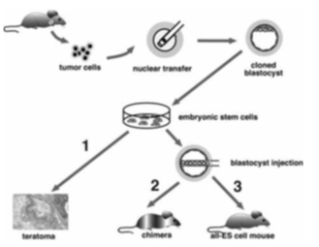
Five lines of evidence 3
Five lines of evidence suggesting evidence of an epigenetically disrupted progenitor cells
3. Melanoma nucleus can give rise to a normal mouse showing
reprogramming potentials
two step procedure
somatic Nuclear Cell Transfer (SCNT) of melanoma nucleus into enucleated oocyte
extracted ESCs from blastocyst and plated to grow ESC lines that were tumorigenic
injected tumorigenic ESCs into new tetraploid blastocysts
almost all the tumor properties were reversed (although some mice had increased incidences of tumors)
Notes:
“Nuclear transplantation (NT) can reprogram a terminally differentiated cell into a pluripotent embryonic cell that can direct development of an organism “
In a two-step cloning process:
1.Used melanoma nucleus
2.Transferred into enucleated oocytes
3.Resultant blastocyst explanted in culture to produce ES cell lines
4.These tumorigenic ESC lines were
Analyzed to confirm tumor cell origins
Tested for tumorigenic potential
Developmental potential i.e. implanted into tetraploid blastocysts into female mouse than examined
“almost all all phenotypic properties of cancer were reversed” albeit these mice had increased melanoma incidence which indicates the tumors are not entirely epigenetic.
Connection: The tumor cells can be reprogrammed in order to make normal cells. This indicates tumor can be epigenetically controlled
In a two-step cloning process, a tumorigenic ESC lines were derived from melanoma nucleus somatic nuclear cell transfer and implanted into tetraploid blastocysts so that the tumorigenic ESCs were exclusive in giving rise to the embryo. These stem cells derived from melanoma nucleus gave rise to entire mouse and “almost all all phenotypic properties of cancer were reversed” albeit these mice had increased melanoma incidence which indicates the tumors are not entirely epigenetic. mor cells can be reprogrammed in order to make normal cells.
This indicates tumors can be epigeneticallyy controlled (since it can be reversed)
Connection: The tumor cells can be reprogrammed in order to make normal cells.
This indicates tumors can be epigeneticallyy controlled (since it can be reversed)

Slide 13

Five lines of evidence 4
YS
5 lines of evidence suggesting evidence of an epigenetically disrupted progenitor cells
4. Neoplastic cells can only be maintained by cells with stem cell
properties
of the brain tumor cells grafted into NOD-SCID mice, only CD113⁺ can initiate tumours in mice while CD113⁻ brain tumor cells could not
Injection of CD133+ tumor cells shown by arrowhead
MRI scan of mouse
Magnification of histogram
Notes:
CD positive medulloblastoma (cancer) cells (CD113 is a cell-surface marker for self-renewing brain stem cells and early progenitor cells)
NOD-SCID (non-obese diabetic, severe combined immunodeficient) mouse brains.
Human tumor cell lines injected into mouse
CD113+ medullablastoma cell 16/19 mouse developed brain tumors
CD113- medulloblastoma cell no tumor cells
A.ARROW head show increasing mass under injection site
C. IS JUST Xenograft show cellular mass below the inejctino site
Connection: this means that progenitor cells are the targets for epigenetic changes in cancer
CD113+ and CD113- brain tumour cells, where CD113+ is a cell surface marker for self-renewal Neuronal Stem Cells (NSCs) were xenografted into 6-8 week old mice in the frontal cortex. As little at 100 CD113+ cells were able to initiate brain tumors in the mice that received CD113+ xenografts but even 10⁵ CD113- brain tumour cells were not proving stemness characteristics are required to induce tumorigenesis.

Slide 14
Five lines of evidence 5
YS
5 lines of evidence suggesting evidence of an epigenetically disrupted progenitor cells
5. Loss of imprinting
biallelic expression of Igf2 (Instead of paternal IGF2 and maternal H19nc) lead to shift in balance toward increased ratio progenitor to differentiated cells.
Explained in detail in Chris’s portion
Notes:
Biallelic expression of IGF2 due to activation of silent maternal allele as we have learned in class
They also had longer intestinal crypts, the site for epithelium renewal shown by increased progenitor cell markers
How exactly ? They used
1.Min mice with Apc mutation
2.Crossed female H19 +/- with male APC+/Min and compared littermates harboring APC mutation with or without maternally inherited H19 MUTATIONS (Thus with or without LOI)
They used mouse model that took advantage of the fact differentially methylated region (upstream of nearby untranslated H19 gene
Deletion of DMR lead to billaleic expression (LOI) of Igf2
This slide will be discussed further in detail along wiht Chris’s slide
Loss of Imprinting - Biallelic expression of Igf2 (Instead of paternal IGF2 and maternal H19nc) lead to shift in balance toward increased ratio progenitor to differentiated cells.

Slide 15
2nd Step - initiating mutation
BJW
The first step — epigenetic disruption of progenitor cells
The second step — initiating mutation.
The third step — genetic and epigenetic plasticity.
Notes:
The second step of the Epigenetic Progenitor model - the initiating mutation

Slide 16
2nd Step - initiating mutation
BJW
Specific for tumour type:
B-cell and T-cell
Adenomatous polyposis coli (APC) mutation for Colorectal cancer
BCR-ABL for Chronic Myeloid Leukemia
Class can epigenetic alterations can drive tumorigenesis even without a single genetic mutation???
Notes:
The second step is where the clonal genetic model of cancer starts; with the initiating genetic mutation. This presents the time point in which the specific type of cancer or subtype of cancer is characterized. For example Burkitt B-Cell lymphoma is due chromatin instability as a result of hypomethylation and chromosomal rearrangement of c-Myc (chromosome 8) and B-Cell IgH (chromosome 14) or specific to T-Cell ALL where we see 9(region)p deletions/mutations of p16, the cell cycle cyclin-dependent kinase inhibitor we previously indicated along with Notch1 mutations. Other examples include...

Slide 17
2nd Step - initiating mutation
BJW
“Epigenetic alteration can substitute for mutation-induced oncogene activation or tumour-suppressor gene silencing”
(Feinberg et al. 2006)
Notes:
Just read answer here.

Slide 18
3rd Step - genetic and epigenetic plasticity
BJW
The first step — epigenetic disruption of progenitor cells
The second step — initiating mutation.
The third step — genetic and epigenetic plasticity.
Notes:
3rd and final step of Epigenetic progenitor model of cancer - genetic and epigenetic plasticity.

Slide 19
3rd Step - genetic and epigenetic plasticity
BJW
Ability for tumour to stably evolve - tumour microenvironment
Genetic plasticity
Epigenetic changes
Centromere protein H (CENPH) upregulated in cancer
Results in aneuploidy
DNMT1, ↑ PRC2’s EZH2, other Histone marks
Notes:
Genetic and Epigenetic plasticity is basically summarized as the ability for tumour to stably evolve and this relates to the tumour microenvironment from last lecture.
In some places genetic plasticity is well understood in some case such as telomere shortening with age where we have deletion of genetic material at the end of chromosomes during cellular replication.
Epigenetic changes such as active components of centromere protein H are upregulated in cancer resulting in aneuploidy (abnormally low or high amount of chromosome per cell) and occurs during cellular division.
Disruption of normal DNMT1 activity, increased of PRC2’s EZH2, other Histone marks as we will see coming up in Part 2.

Slide 20
PART 2
CS
Chris - Colorectal and Epigenetics
Brian - Hematological Cancers
Yea Ji - Ageing and Cancer
WITH BONUSES IN BIOINFORMATICS!
Notes:
Now we’re going to each talk about specific examples of the epigenetic changes leading to cancer and I’ll be doing colorectal cancer, Brian will be doing hematological cancer and yeaji will be doing ageing and cancer
Request access if you havent done so already

Slide 21
Part 2 - Colorectal Cancer, Loss of imprinting¹
CS
Previously in the Clonal genetic model
Shortcomings include inability to explain specific stages of tumor development
Loss of imprinting (LOI)
LOI of the insulin growth factor 2 (IGF2)
This LOI causes an increase in progenitor cells in the kidney in Wilms tumors in children and in the GI tract in patients with colorectal cancer.
Notes:
As we talked about before from the clonal genetic model, without any step regarding epigenetic disruptions to the cells, it was able to easily describe
1a - Cancer arising from a combination of genetic alterations from a single cell
It was also very useful in predicting “gatekeeper mutations” which we talked about before that are integral for tumor development
1c - Other than the gatekeeper mutation, there are no other known necessary mutations in the different stages of tumors
Some explanation of the shortcoming of the clonal genetic model (at least for colorectal cancer and some others) is the loss of imprinting in colorectal cancer
LOI - refers to either the activation of a normally silenced imprinted gene or the silencing of a normally active imprinted gene
2 - LOI of insulin growth factor igf2 is found in nearly half the cases of the Wilms tumors found in children and is also well known to be a epigenetic factor in adults and leaves these adults to a much higher predisposition to colorectal cancer.
In case someone wants to ask why it is this specific insulin growth factor that causes this increase in progenitor cells, that goes beyond the scope of this presentation

Slide 22
Colorectal Cancer, Loss of imprinting¹
CS
IGF2 - a tumor progenitor gene
LOI leads to increase in progenitor cell compartment
Thinking back to the Epigenetic Progenitor Model
Notes:
I talked briefly before about tumor progenitor genes and how they were described as promoting epigenetic disruption and regulating ‘stemness’ itself, affecting pluripotency and unlimited self-renewal.
If we think about the example of IGF2 as expanding the progenitor cell population, as indicated from the excerpt from Feinberg’s paper, this also fits the epigenetic progenitor model of a tumor progenitor gene as IGF2 expands the progenitor cell population by means of epigenetic changes. So if we look at the diagram on the top right, this refers to step one, the TPG causing an expanded or epigenetically altered progenitor cell pool.

Slide 23
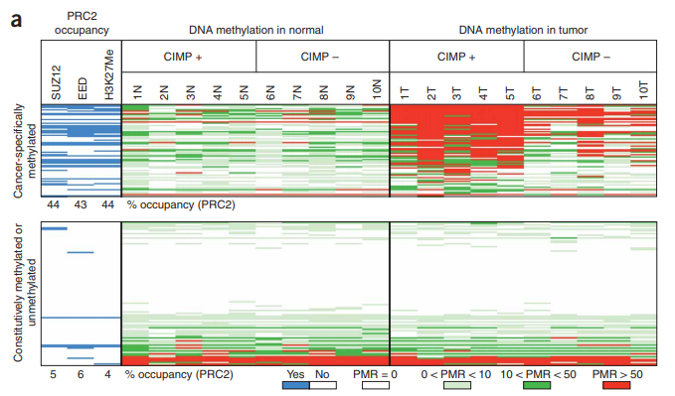
Bioinformatics Application Colorectal Cancer³
CS
ChIP-seq was used to obtain PRC2 data
Polycomb repressive complex 2 (PRC2) upregulation
DNA Methylation using a MethyLight assay¹⁴.
Notes:
Now I’ll briefly go over some data relating to colorectal cancer and epigenetics produced by bioinformatics analysis
PRC2, as we remember from chapter 17, is a complex of methyltransferases that mono, di, and trimethylates histone H3K27, and this methylation is related to gene silencing.
If we look at the heat map above, on the left side of the diagram this data was obtained using ChIP-seq, this shows the occupancy data of SUZ12, EED, and trimethylation status of H3K27 on 177 genes. The blue means that the protein or trimethylation status is preset on a gene, and white means there is no presence. In cancer cells we can clearly see that the presence of these PRC2 related proteins and trimethylation status of H3K27 is very high, which is reflective of the results on the right.
On the right side of the heatmap, the DNA methylation of colorectal tumors is shown and this data was obtained by MethyLight assay, a qPCR method which can detect methylation in genomic DNA (and PMR stands for percentage methylation reference). This clearly shows DNA hypermethylation in tumors.
Now, Brian will talk about how epigenetic factors play a role in hematological cancers.

Slide 24
Part 2 - Hematological Cancers
BJW
DNA Methylation role in blood cell development
DNMT1
DNMT3A
TET2
HoxA9 and Meis1 role in HSC self-renewal
Notes:
We did a little bit of research into hematological cancers; leukemias and lymphomas, and saw these cancers we very relatable to the CSC topic, if not having the most association. We already spoke a little bit amount DNA methyltransferases and Homeobox proteins HoxA9 and Meis1 and now we will see the relation in a study involving Hematopoiesis and hematological cancers with Bioinformatics relevance.

Slide 25
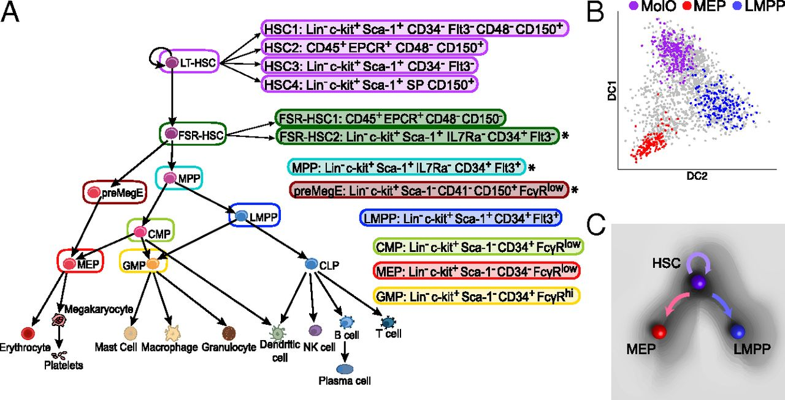
Hematopoietic stem cells (HSCs)
BJW
Hematopoietic stem cells reside in the bone marrow
Defined by their capacity for the lifelong maintenance of blood and bone marrow
Achieved through their differentiation into a myriad of cell types, as well as the regeneration of stem cells via self-renewal. (Challen et al. 2011) ⁴
(Hamey et al. 2016) ⁵
Notes:
Hematopoietic stem cells reside in the bone marrow and are defined by their capacity for the lifelong maintenance of blood cells and bone marrow, [this is] achieved through their differentiation into a myriad of cell types, as well as the regeneration of stem cells via self-renewal. (Challen et al. 2011) ⁴.
Hopefully when you are reading study after study of Hematopoiesis you will see may see LSK mentioned when referring to HSCs. This just stands for Lineage dependent (see negative for HSCs) Sca-1+, and c-Kit+.

Slide 26
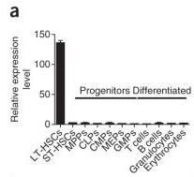
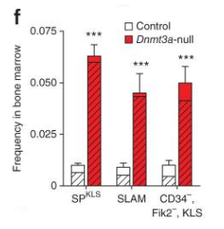
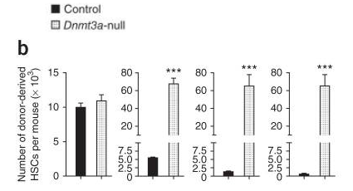
HSCs and Hematopoiesis
BJW
Dnmt3a critical in the epigenetic silencing of HSC regulatory (self-renewal) genes, thereby enabling efficient differentiation. (Challen et al. 2011) ⁴
Dnmt3a-null HSCs again regenerated remarkable numbers of HSCs, with an average of 50-fold more HSCs derived from Dnmt3a-null cells than from their control counterparts. (Challen et al. 2011) ⁴
Notes:
A study was done by Dr. Grant Challen with others as mutations in Dnmt3a account for 20% of Acute Myeloid Leukemia cases. Dnmt3a is a critical participant in the epigenetic silencing of HSC regulatory genes [those responsible for self-renewal of HSCs], thereby enabling efficient differentiation [of HSCs]. (Challen et al. 2011) ⁴.
To the right in figure A, PCR analysis shows that Dnmt3a is expressed more than 10-fold higher in long-term HSCs over lineage specific progenitor cells indicating its role in hematopoiesis and lineage differentiation at the stem-cell level. While figure A doesn’t necessarily indicate the role of Dnmt3a in HSC differentiation, this is complemented by figure F where by ablation/knockout of Dnmt3a cells which were transplanted from primary recipient to secondary recipients in red which shows large increases in HSCs in bone marrow in Dnmt3a-null cells compared to the control over 3 different phenotypes. This shows that knockout of Dnmt3a increases HSC self-renewal and indicates Dnmt3a’s role in inducing stem-cell differentiation, specifically by silencing self-renewal specific genes.
Finally to predict the effect of Dnmt3a knockout on long-term HSCs differentiation they purified HSCs from secondary recipients and transplanted into tertiary recipients with 3 different experimental replicates. Again Dnmt3a-null regenerated 50-fold increase in HSCs in bone marrow showing that Dnmt3a mutant cells blocks differentiation.

Slide 27
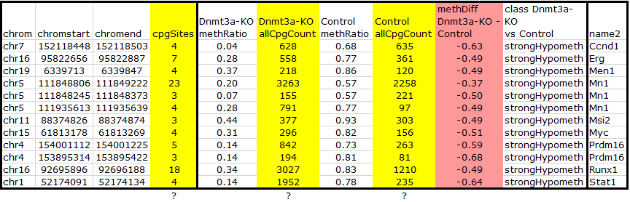
Relation to Hematological Malignancies
BJW
741 hypomethylated DMRs associated with 434 genes in Dnmt3a-null HSCs. Many of the hypomethylated genes are commonly associated with human hematopoietic malignancies, such as Prdm16, Stat1, Ccnd1, Myc, Mn1, Msi2, Men1, Erg and Runx1. (Challen et al. 2011) ⁴
Notes:
Bioinformatics exploration included targeted bisulfite sequencing for differential methylation analysis. They consorted with KEGG Pathway database and Oncomine, a ThermoFisher bioinformatics platform for translational medicine research. They discovered 741 hypomethylated differentially methylated regions (DMRs) which was defined as having at least 3 nearby differentially methylated CpGs. Of these 741, 434 genes in Dnmt3a-null mice were strongly hypomethylated which leads to enrichment of mRNA expression of these genes. Through KEGG and Ocomine exploration they discovered many of these hypomethylated genes are associated with hematological cancers such as AML, ALL, and B-cell ALL.
Why 3 columns for CpG sites with respect to just individual genes and why are two columns so high?

Slide 28
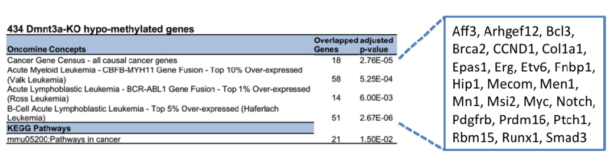
Relation to Hematological Malignancies
BJW
Notes:
Here is statistical analysis that can be performed with Oncomine Concepts platform and KEGG Pathways database.
In concluding the study, the paper indicates in agreement with Feinberg that “although hypomethylation per se may not be oncogenic in stem cells, the inability to shut down stem cell genes during differentiation may drive transformation with a secondary oncogenic event”. (Challen 2011) (i.e. epigenecting precedes genetic).

Slide 29
DNA Methyltransferases
BJW
Is there treatment to mutant Dnmt3a in certain types of leukemias?
Class what about other DNMTs? Do you hypothesize same or similar results?
Notes:
Is there treatment to mutant Dnmt3a in certain types of leukemias? Not necessarily directly. Studies have shown correlation with leukemias associated with mutation or deletion of Dnmt3a with histone H3K79 methylation. We will discuss motivation for therapies at the end with respect to this correlation.
What about other DNMTs? Would we expect same or similar results from other studies?

Slide 30
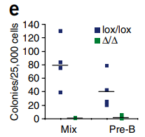
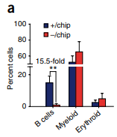
HSCs and Hematopoiesis - A Little Complicated?
BJW
Completed Dnmt1 knockout, mice HSCs were not able to differentiate to myeloid or B-cell.
Notably, HSCs from mice with reduced [Dnmt1] activity cannot suppress key myeloerythroid regulators and thus can differentiate into myeloerythroid, but not lymphoid, progeny. (Bröske et al) ⁶
Ablation DNMTs -> Leukemia or Lymphoma more likely?
Blue = Dnmt1+/+
Green = Dnmt1 -/-
Mix = Myeloid and B-cell
Blue = Dnmt1+ /
Dnmt1 hypomorphic
Orange = Dnmt1- /
Dnmt1 hypomorphic
Notes:
Not necessarily. In study by Broske, they found that complete ablation of Dnmt1 blocked differentiation to myeloid and B-cell lineages and disrupts HSCs differentiation potential. So this experiment gave same results. However since Dnmt1 double negative mice did not survive very long they also experimented with combining a hypomorphic Dnmt1 allele with Dnmt1 negative knockout and Dnmt1 positive control. Haplo knocking out Dnmt1 found HSCs still differentiated to myeloid progenitor but not lymphoid.
This begs the question to whether ablation of DNMTs would primarily relate to inducing leukemic cancer over lymphomas?

Slide 31
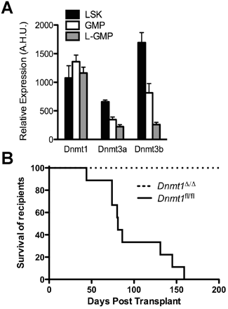
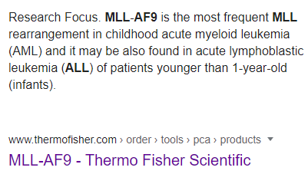
HSCs and Hematopoiesis - Even more Complicated??
BJW
Department of Pediatric Oncology,
Dana-Farber Cancer Institute
LSK: Lin Sca-1+ c-Kit+ (HSCs)
GMP: granulocyte– macrophage progenitors
L-GMP: leukemic granulocyte– macrophage progenitors
(Trowbridge et al. 2012) ¹⁰
Notes:
Interestingly the textbook by Peter A. Jones cited this specific study by Broske with respect to Dnmt1. On the contrary study at Dana-Farber Cancer Institute in 2012 (which also cited Broske) links knockout of Dnmt1 to actually blocking leukemia (specifically MLL-AF9-induced AML) development and progression, meaning inhibiting Dnmt1 blocks self-renewal and proliferation of leukemic stem cells. The figure on top right shows that Dnmt1 is consistently higher in all three cell types LSK HSCs, granulocyte–macrophage progenitors and leukemic granulocyte–macrophage progenitors. The figure to the bottom right shows complete knockdown double - for Dnmt1 cells fail to develop AML whatsoever. Later study in single allele knockdown of Dnmt1 (figure not shown) in pre-existing leukemia slowed the progression of leukemic cell self-renewal and increased survival time. Where in the previous paper by Challen indicated the theory that blocking Dnmt3a promotes self-renewal in HSCs.
We talked about fusion proteins in the last lecture with the human trithorax gene MLL. MLL-AF9 fusion is the most frequent rearrangement in childhood AML and also found in ALL in infants. From the Uniprot database “[AF-9] plays a key role in hematopoietic stem cell (HSC) maintenance by preserving, rather than conferring, HSC stemness (PubMed:31776511). Acts by binding to the transcription start site of active genes in HSCs and sustaining level of H3K79me2, probably by recruiting DOT1L”. We will see at the end of the presentation some therapeutic motivation specifically related to H3K79 methylation and DOT1L.

Slide 32
Excerpts from (You and Jones 2012) ⁷
BJW
Recent studies uncovered a role of DNMT3A in silencing self-renewal genes in hematopoietic stem cells (HSCs) to permit efficient hematopoietic differentiation and its loss progressively impairs HSC differentiation (Challen et al., 2011; Trowbridge and Orkin, 2011).
All known DNMT3A mutations are related to poor survival in AML(Ley et al., 2010; Yan et al., 2011), suggesting that these mutations prevent differentiation and have an important role in the progression of disease. (You and Jones) ⁷
Notably, TET2 loss-of-function mutations were mutually exclusive of mutations in IDH1 (isocitrate dehydrogenase1) and IDH2, which are known to induce DNA hypermethylation and impair differentiation in hematopoietic cells (Figueroa et al., 2010).

Slide 33
Polycomb group targets (Teschendorff et al., 2010) ¹⁹
YJS
Hypothesis using two connection
1. promoters of PCGT that is methylated in cancer ¹⁹
2. cancer increases with age as with methylation changes
Study definition of PCGT
Promoter occupancy at CpG of SUZ12, EED or H3K27me3 in hESC ¹⁹
Tested on blood cells and epithelial cells to see age-PCGT CpG methylation signature ¹⁹
See this level in cancer
Study method (including stem cells in 1&2)
1. age dependent signature from blood samples
2. validation : in independent blood sample and epithelial tissue
3. see these changes in cancerous epithelial tissue
Notes:
ag-PCGT methylation signature
The 69 PCGT CpGs as “age-PCGT” CpG
In recent study-->Stem cell: undergo PCGTs in HESC undergo cancer specific hypermethylation compared to Non targets
Targets? Subunits of PRC3
Age may induce DNAm of PCGTs therefore predisoposing people of cancer
PRC2 Subunits:
Suz12-enhances HMTas activity
Eed: Enhances HMTases activities
Not mentioned subunit, EZH2 (SET domain, methylate H3K27)
Exact mechanism of de novo methylation with DNMT3 unknown

Slide 34
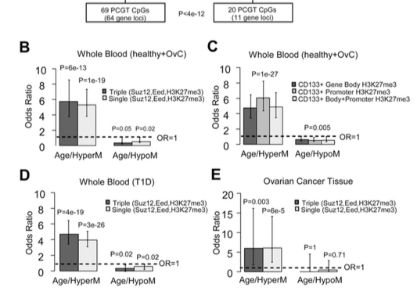
Age related hypermethylation is independent of cell type
YJS
Independent of- “sex, disease, tissue, or cell type” ¹⁹
B. Fivefold increase in PCGT CpG, compared to
non-PCGT CpG ¹⁹
C. Five Fold enrichment of H3K27me3 in PCGT
CpG, specifically in HSC ¹⁹
D. T1D (female & male), enrichment of PCGT CpG
¹⁹
E. Ovarian cancer patients, enrichment of PCGT
CpG ¹⁹
Y-axis: Enrichment odds ratio
X-axis: Donor age
Notes:
1.Blood sample from 261 post menapausal women spanning 30 years=148 healthy and 113 ovarian cancer
DNAm profiling (Illumina Infium 27K ) of peripheral blood samples bisulfite sequencing
2.Out of 25,462 CpG sites, they defined PCGT promoters by EEZ, SUZ12 and H3K27me3 site and Found 69 CpG of PCGT with 64 unique gene loci
3.the 69 PCGT CpGs as age related signature, (henceforth ‘‘age-PCGT’’ CpGs) (Teschendroff et al., 2010)
Found DNAm changes independently of disease state, sex, tissue, and cell type.
B. PCGT more likely to be methylated by fivefold than non PCGT and in contrast 11 PCGT hypomethylation found with age in whole blood
C. In CD133+ Hematopoietc Stem cells specifically, they found FIVEFOLD Enrichment of H3K27me3 marks fin gene body or promoter region from whole blood
D. Validation In whole blood of Type 1 diabetes from both men and female, enrichment of PCGT among CpG undergoing hypermethylation but not hypomethylation
E validation . Women with ovarian cancer, same result as D

Slide 35
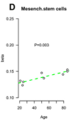
Increased methylation seen in stem cells
Validation in MSC DNAm increase in 59/69 PCGT CpG ¹⁹
Y-axis: 69-age hypermethylated PCGT CpG
X-axis: Donor age
Notes:
Eight samples of Mesenchymal stem cells bone marrow (24-88yrs)
Yes it was a small pool, but it still showed increased with age
Validation in stem cell specifically in MSC (69 age hypermethylated PCGT)
2d.69 PCGT CpG signatures reflected in Mulitpotent progenitor and stem cell pools? Yes, it was shown 59/69 CpG was hypermethylated demonstrating increase

Slide 36
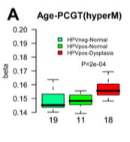
Increase in methylation due to age-can differentiate cancer vs. non-cancer
YJS
A. Increase in DNAm in cancerous tissue vs. normal tissue
Y-axis: 69-age hypermethylated PCGT CpG
X-axis: from left to right HPVnegative-Norm ((green)
HPVpositive-Normal (green)
HPVpositiv-Dysplasia (red)
Notes:
●A,B) Average methylation values of the 69 age-hypermethylated and 20 -- PCGT CpGs as a function of disease status in 48 cervical cytology samples.
A. It clealrly shows sthat HPVsampleshowing dysplasia shows higher level of PCGT methyaltion than the other two normal samples
Dysplasia defition-presence of abnormal cell types, signify a stage before development of cancer

Slide 37
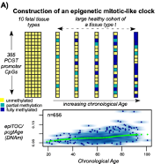
Application of PCGT-Epigenetic Timer Of Cancer (epiTOC) (Yang et al., 2016) ²¹
YJS
epiTOC
It can predict cancer due to stem cell alterations (division rate) caused by increased methylation at PCGT CpG
Requirement for epiTOC
CpG criterias
unmethylated CpG in fetal tissue types
CpGs mapped for PCGT as stated previously
CpGs methylation that is increased with age at PCGT
Notes:
World bank
epiTOC score or pcgtAge score using 385 PCGT/PRC2
Not random but specific PCGT that is hypermethylated
Pcgt age average DNAm over these 385 sites
epiTOC rate using pcgtAge estimates stem cell rate division per stem cell
epiTOC/pcgtAge
pcgtAge (DNAm)
So it uses methylation changes at the promoter CpGs targetd by Polycomb groups and compare the normal stem cell rate division against cancer cell rate divison. This can predict the mitotic rate of cancer cells due to the changes that has occurred in stem cells due to epigenetic alterations
They isolated each tissue type since it would be more accurate to see the mitotic rate in each type of cells
Break down slides
1. Using 650 whole blood samples from healthy individuals, They estimated over 385 PCGT/PRC2 marked promoters CpGs that are unmethylated in 37 fetal tissue from 12 tissue types.
They found 385 sites to start that changes that could account for DNA methylation changes
And also provide number of stem cell division to start with
Samples from 656 individuals whose DNAm changes were assed over one tissue type (blood)
Lower panel They found linear relationship of increase in DNA methylation with age using just one tissue type

Slide 38
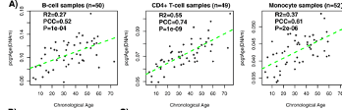

epiTOC shows increase in methylation with age-in all blood cell types, including stem cells
YJS
epiTOC predicts age in all blood cell types
pcgtAge vs. chronological age
fraction of 385 PCGT sites are all hypermethylated
in the three samples of blood cell type (A) ²¹
epiTOC predicts stem cell age
D. (Top) correlation of pcgtAge in MSC ²¹
(Bottom) correlation of pcgtAge in HPC ²¹
Y axis: pcgtAge (DNAm)
X axis: Donor age
Notes:
Methylation increases in pcgtAge sows that it correlates with age
A. B CELLS T CELLS, Monocytes
Bottom
Mesenchymal stem cell
HPC hematopoieitc progenitor cell

Slide 39
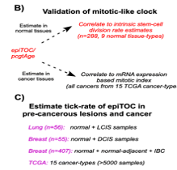
Validation and rate of epiTOC
YJS
B. Validation using stem cell division rate & mRNA
levels-TCGA ²¹
C. See if epiTOC-pctgAge signature is increased in
cancer tissue ²¹
Notes:
TCGA-The Cancer Genome Atlas
2. Rate of stem cell division via TCGA in normal tissues
2. Rate of mRNA expression (protein levels in cancer) also from TCGA
3. Assessment to see if epiTOC/pcgtAge rate is accelerated in cancerous tissue

Slide 40
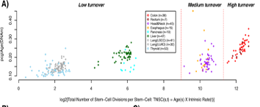
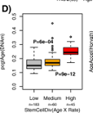
Stem cell rate division
YJS
epiTOC can approximate like mitotic-like clock (n=288, 9 different tissue types) ²¹
They were able to insure stem cell rate division (Yang et al., (2016) ²¹
cells divided by types, grouped into three groups (low, medium, high turnovers) ²¹
D. different pcgtAge in the three cancer groups
Y axis: pcgtAge (DNAm)
X axis: Cell division rate per stem cell
Notes:
Seperate slides
Put in rate down for tunrover rate
Increased mRNA expression of genes in cell proliferation clusters because increased level of these genes are seen in tumor
Go over present at least 3 times
Go over hard to pronounce words, and thoughts
LSCC: Lung squamos cell caricinoma
LUAD:Lung adenomacarcinoma

Slide 41
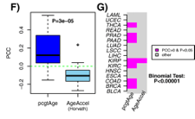
Increased mRNA levels of proliferation clusters
YJS
F. pcgtAge groups showed higher levels of mRNA
expression levels (that is genes that are expressed in
tumor cells)( Rhodes et al., 2004) ²⁵
G. Heatmap: Pink shows the different levels of proteins
for the positive pcgtAge groups
Y axis: Increased mRNA levels of proliferation clusters
X axis: pcgtAge (DNAm)
Notes:
Genes in proliferation clusters meaning gene expression that is activated in tumor type cells

Slide 42
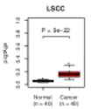
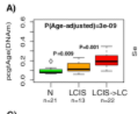
epi-Toc predicts pre-cancerous lesions
YJS
Trend in increase in methylation between normal, LCIS ,and LCIS that developed into invasive lung cancer
LSCC-lung squamous cell carcinoma
LCIS-lung carcinoma in situ
Y axis: pcgtAge (DNAm)
X axis: Normal vs. Cancer
Y axis: pcgtAge (DNAm)
X axis: Normal, LCIS, LCIS->LC
Notes:
From previous figure they showed pcgtAge/epiTOC model showed universal age acceleration in cancer from 15 different samples attained from TCGA.
This particular one on the left is of the 15 which was LSCC lung squamos cell carcinoma vs normal
To take it one step further, they tried to see if they can predict pre-cancerous lesions. Answer is yes
Lower panel shows normal lung vs, lung carcinoma in situ vs LCIS that developed into invasive lung cancer. It shows positive increase in methylation,

Slide 43
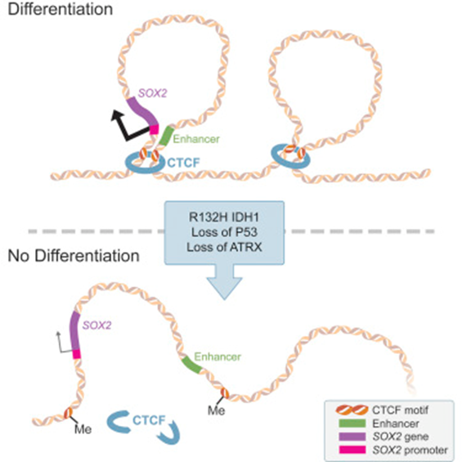
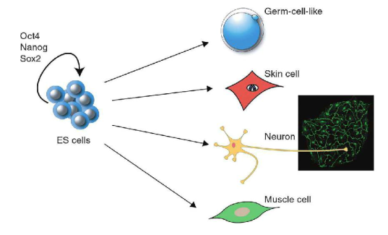
Difficulties - I’m confused? - Give me a Break?!
BJW
Repression of SOX2 as an early driver of gliomagenesis ⁹
↓ Sox2
↓NSCs differentiation
NSCs
ESCs
↑ Sox2 ↓ESCs differentiation
The differentiation block is mediated by transcriptional silencing of SOX2 ⁹
Notes:
Remember from my Presentation regarding IDH mutations lead to decreases in amounts of alpha-ketoglutarate for active DNA demethylation and histone demethylation. We see that upregulation of Sox2 blocks differentiation in ESCs but conversely in the case of Neuronal Stems Cell downregulation of Sox2 blocks differentiation and drives gliomagenesis. However, another study of Sox2 indicates “In addition to gene amplification, overexpression of Sox2 has been reported in a number of human brain tumors including glioblastoma and medulloblastoma.” ¹³ The study goes further and even indicates “the promoter of SOX2 was also found to be hypomethylated, which leads to its aberrant expression in brain tumors such as glioblastoma (GBM), reflecting the more primitive cellular state that is also found in neural stem cells (NSCs). This is saying the opposite, so which is it???

Slide 44
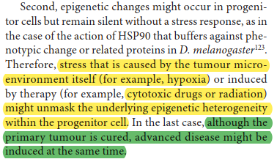
Difficulties - Helping or Hurting?
Chemotherapy and radiation can even induce onset of different disease by unmasking late onset of epigenetic alteration.
Notes:
Like brian mentioned in the beginning of the presentation, there are some surviving properties of cancer stem cells that could be responsible for tumor relapse after successful therapy.
Some more difficulties include that chemotherapy for one type of cancer at the time could lead to cancer at a later time. Say for example there are 200 cells that have the same epigenetic footprint but only 100 are the ones causing cancer due to some mutation after the epigenetic change. If chemotherapy is done, the initial 100 cells that are cancer causing could be targeted and destroyed, but the other 100 cells that weren’t initially oncogenic could undergo mutagenesis to become oncogenic, leading to another form of cancer later down the line.
This shows that epigenetic changes come first and then mutation happens which lead to cancer
then brian will go into the motivations of this

Slide 45

Motivation
BJW
Many of these therapeutic strategies aim to induce differentiation of CSCs and to sensitise these cells to chemotherapy, with the ultimate goal of reducing tumor relapse and improving patient (Tol et al. 2017) ¹²
Drug | Name | Function/Target | Phase | Disease/Cancer Type
EPZ-5676 | Pinometostat | Inhibits DOT1L KMT (H3K79) Activation HoxA9 & Meis1 | Phase 1B/2 | MLL-fusion leukemia, AML, ALL
Beleodaq | Belinostat | HDACi Class 1 & 2 | FDA Approved 2014 | Recurrent/refractory cutaneous Peripheral T-cell lymphoma
Notes:
As previously indicated mutant Dnmt3a leukemias especially AML has been associated with increased expression of DOT1L. In addition, translocation of Mixed Lineage Leukemia (MLL) genes accounts for ¾ of pediatric leukemias. MLL fusion protein can recruit DOT1L lysine methyltransferase into a transcription complex, which methylates H3K79, primarily an activating mark. This leads to dysregulation and overexpression of many MLL-target genes, including Homeobox A9 (HoxA9) and Meis homeobox 1 (Meis1) (Toh et al. 2017) ¹² . These two genes are major regulators of HSC differentiation and leukemogenesis in that they are associated with HSCs self-renewal.
Another study at Memorial Sloan Kettering Cancer Center confirms MLL-AF9 fusion proteins target downstream expression of HoxA9 and Meis1-mediated AML (acute myeloid leukemias) and promotes stem cell self-renewal. (Zhu et al. 2016) ¹⁵. A third study also confirms that in normal hematopoiesis, Meis1 expression among the various cell compartments is correlated with the degree of self-renewal, with the levels being highest in hematopoietic stem cells (HSCs) (Unnisa et al. 2013) ¹⁶. So gene activation does not necessarily promote differentiation, it matters which genes. Activation of HoxA9 and Meis1 block HSC differentiation.
Pinonmetostat is a DOT1L Histone Lysine Methyltransferase inhibitor that is currently recruiting in a Phase 1B/2 trial. It’s aim in inhibiting DOT1L’s methylation target H3K79 which activates self-renewal homeobox genes HoxA9 and Meis1. By inhibiting the activation of these genes this can induced differentiation of HSCs and leukemia cells in various types of leukemias such as MLL-fusion, AML and ALL.
Belinostat is an HDACi specific to class 1 and 2 HDACs and is in the most studied class of HDAC inhibitors, called hydroxamate inhibitors.
According to NCBI’s PubChem, Belinostat targets HDAC enzymes, thereby inhibiting tumor cell proliferation, inducing apoptosis, promoting cellular differentiation, and inhibiting angiogenesis. (NCBI PubChem 2020) ¹⁸. So we see there is exciting opportunity in the class of medicine that induces cellular differentiation of tumour cells instead of destroying tumour cells.
SKIP
The mechanism of action is fascinating where because class 1/2 HDACs require a zinc atom and well positioned water molecule in their active sites (see chapter 5 of our textbook) “hydroxamic acid coordinates the zinc ion through it carbonyl and hydroxyl groups” (Seto and Yoshida 2014) ¹⁷ and also replaces hydrogen bonds between the water molecule and key residues in HDAC class 1/2 active site to inhibit their catalysis.

Slide 46
Resources
Feinberg, A., Ohlsson, R. & Henikoff, S. The epigenetic progenitor origin of human cancer. Nat Rev Genet 7, 21–33 (2006). https://doi.org/10.1038/nrg1748
Baylin, S. B., & Jones, P. A. (2016). Epigenetic Determinants of Cancer. Cold Spring Harbor perspectives in biology, 8(9), a019505. https://doi.org/10.1101/cshperspect.a019505
Widschwendter, M., Fiegl, H., Egle, D. et al. Epigenetic stem cell signature in cancer. Nat Genet 39, 157–158 (2007). https://doi.org/10.1038/ng1941
Challen, G. A., Sun, D., Jeong, M., Luo, M., Jelinek, J., Berg, J. S., Bock, C., Vasanthakumar, A., Gu, H., Xi, Y., Liang, S., Lu, Y., Darlington, G. J., Meissner, A., Issa, J. P., Godley, L. A., Li, W., & Goodell, M. A. (2011). Dnmt3a is essential for hematopoietic stem cell differentiation. Nature genetics, 44(1), 23–31. https://doi.org/10.1038/ng.1009
Hamey, F. K., Nestorowa, S., Kinston, S. J., Kent, D. G., Wilson, N. K., & Göttgens, B. (2017). Reconstructing blood stem cell regulatory network models from single-cell molecular profiles. Proceedings of the National Academy of Sciences of the United States of America, 114(23), 5822–5829. https://doi.org/10.1073/pnas.1610609114

Slide 47
Resources
Bröske, A., Vockentanz, L., Kharazi, S. et al. DNA methylation protects hematopoietic stem cell multipotency from myeloerythroid restriction. Nat Genet 41, 1207–1215 (2009). https://doi.org/10.1038/ng.463
You, J. S., & Jones, P. A. (2012). Cancer genetics and epigenetics: two sides of the same coin?. Cancer cell, 22(1), 9–20. https://doi.org/10.1016/j.ccr.2012.06.008
Cui H. Loss of imprinting of IGF2 as an epigenetic marker for the risk of human cancer. Dis Markers. 2007;23(1-2):105–112. doi:10.1155/2007/363464
Modrek, A. S., Golub, D., Khan, T., Bready, D., Prado, J., Bowman, C., Deng, J., Zhang, G., Rocha, P. P., Raviram, R., Lazaris, C., Stafford, J. M., LeRoy, G., Kader, M., Dhaliwal, J., Bayin, N. S., Frenster, J. D., Serrano, J., Chiriboga, L., Baitalmal, R., … Placantonakis, D. G. (2017). Low-Grade Astrocytoma Mutations in IDH1, P53, and ATRX Cooperate to Block Differentiation of Human Neural Stem Cells via Repression of SOX2. Cell reports, 21(5), 1267–1280. https://doi.org/10.1016/j.celrep.2017.10.009

Slide 48
Resources
Trowbridge JJ, Sinha AU, Zhu N, Li M, Armstrong SA, Orkin SH. Haploinsufficiency of Dnmt1 impairs leukemia stem cell function through derepression of bivalent chromatin domains. Genes Dev. 2012;26(4):344–349.
Nojima, M., Suzuki, H., Toyota, M. et al. Frequent epigenetic inactivation of SFRP genes and constitutive activation of Wnt signaling in gastric cancer. Oncogene 26, 4699–4713 (2007). https://doi.org/10.1038/sj.onc.1210259
Toh, T. B., Lim, J. J., & Chow, E. K. (2017). Epigenetics in cancer stem cells. Molecular cancer, 16(1), 29. https://doi.org/10.1186/s12943-017-0596-9
Edward Giovannucci, Meir J. Stampfer, Graham A. Colditz, Eric B. Rimm, Dimitrios Trichopoulos, Bernard A. Rosner, Frank E. Speizer, Walter C. Willett, Folate, Methionine, and Alcohol Intake and Risk of Colorectal Adenoma, JNCI: Journal of the National Cancer Institute, Volume 85, Issue 11, 2 June 1993, Pages 875–883, https://doi.org/10.1093/jnci/85.11.875
Campan M., Weisenberger D.J., Trinh B., Laird P.W. (2009) MethyLight. In: Tost J. (eds) DNA Methylation. Methods in Molecular Biology, vol 507. Humana Press

Slide 49
Resources
Zhu, N., Chen, M., Eng, R., DeJong, J., Sinha, A. U., Rahnamay, N. F., Koche, R., Al-Shahrour, F., Minehart, J. C., Chen, C. W., Deshpande, A. J., Xu, H., Chu, S. H., Ebert, B. L., Roeder, R. G., & Armstrong, S. A. (2016). MLL-AF9- and HOXA9-mediated acute myeloid leukemia stem cell self-renewal requires JMJD1C. The Journal of clinical investigation, 126(3), 997–1011. https://doi.org/10.1172/JCI82978
Unnisa, Z., Clark, J. P., Roychoudhury, J., Thomas, E., Tessarollo, L., Copeland, N. G., Jenkins, N. A., Grimes, H. L., & Kumar, A. R. (2012). Meis1 preserves hematopoietic stem cells in mice by limiting oxidative stress. Blood, 120(25), 4973–4981. https://doi.org/10.1182/blood-2012-06-435800
Seto, E., & Yoshida, M. (2014). Erasers of histone acetylation: the histone deacetylase enzymes. Cold Spring Harbor perspectives in biology, 6(4), a018713. https://doi.org/10.1101/cshperspect.a018713
National Center for Biotechnology Information. PubChem Database. Belinostat, CID=6918638, https://pubchem.ncbi.nlm.nih.gov/compound/Belinostat (accessed on Apr. 27, 2020)

Slide 50
Resources
Zhu, N., Chen, M., Eng, R., DeJong, J., Sinha, A. U., Rahnamay, N. F., Koche, R., Al-Shahrour, F., Minehart, J. C., Chen, C. W., Deshpande, A. J., Xu, H., Chu, S. H., Ebert, B. L., Roeder, R. G., & Armstrong, S. A. (2016). MLL-AF9- and HOXA9-mediated acute myeloid leukemia stem cell self-renewal requires JMJD1C. The Journal of clinical investigation, 126(3), 997–1011. https://doi.org/10.1172/JCI82978
Unnisa, Z., Clark, J. P., Roychoudhury, J., Thomas, E., Tessarollo, L., Copeland, N. G., Jenkins, N. A., Grimes, H. L., & Kumar, A. R. (2012). Meis1 preserves hematopoietic stem cells in mice by limiting oxidative stress. Blood, 120(25), 4973–4981. https://doi.org/10.1182/blood-2012-06-435800
Seto, E., & Yoshida, M. (2014). Erasers of histone acetylation: the histone deacetylase enzymes. Cold Spring Harbor perspectives in biology, 6(4), a018713. https://doi.org/10.1101/cshperspect.a018713
National Center for Biotechnology Information. PubChem Database. Belinostat, CID=6918638, https://pubchem.ncbi.nlm.nih.gov/compound/Belinostat (accessed on Apr. 27, 2020)

Slide 51
Resources
Teschendorff, A. E., Menon, U., Gentry-Maharaj, A., Ramus, S. J., Weisenberger, D. J., Shen, H., Campan, M., Noushmehr, H., Bell, C. G., Maxwell, A. P., Savage, D. A., Mueller-Holzner, E., Marth, C., Kocjan, G., Gayther, S. A., Jones, A., Beck, S., Wagner, W., Laird, P. W., Jacobs, I. J., … Widschwendter, M. (2010). Age-dependent DNA methylation of genes that are suppressed in stem cells is a hallmark of cancer. Genome research, 20(4), 440–446. https://doi.org/10.1101/gr.103606.109
2.Lee, T. I., Jenner, R. G., Boyer, L. A., Guenther, M. G., Levine, S. S., Kumar, R. M., Chevalier, B., Johnstone, S. E., Cole, M. F., Isono, K., Koseki, H.,Fuchikami, T., Abe, K., Murray, H. L., Zucker, J. P., Yuan, B., Bell, G. W., Herbolsheimer, E., Hannett, N. M., Sun, K., … Young, R. A. (2006). Control of developmental regulators by Polycomb in human embryonic stem cells. Cell, 125(2), 301–313. https://doi.org/10.1016/j.cell.2006.02.043

Slide 52
Resources
Yang, Z., Wong, A., Kuh, D. et al. Correlation of an epigenetic mitotic clock with cancer risk. Genome Biol 17, 205 (2016). https://doi.org/10.1186/s13059-016-1064-3
Beerman, Isabel & Bock, Christoph & Garrison, Brian & Smith, Zachary & Gu, Hongcang & Meissner, Alexander & Rossi, Derrick. (2013). Proliferation-Dependent Alterations of the DNA Methylation Landscape Underlie Hematopoietic Stem Cell Aging. Cell stem cell. 12. 10.1016/j.stem.2013.01.017.
Christensen, B. C., & Kelsey, K. T. (2016). A new timepiece: an epigenetic mitotic clock. Genome biology, 17(1), 216. https://doi.org/10.1186/s13059-016-1085-y
Zannow, C.A., & Baylin, S.B. (2010). Epigenetic Networks and miRNAs in Stem Cells and Cancer. Molecular Cell. Volume 39; Issue 5. P657-828. DOI: https://doi.org/10.1016/j.molcel.2010.08.036

Slide 53
Resources
Rhodes, D. R., Yu, J., Shanker, K., Deshpande, N., Varambally, R., Ghosh, D., Barrette, T., Pandey, A., & Chinnaiyan, A. M. (2004). Large-scale meta-analysis of cancer microarray data identifies common transcriptional profiles of neoplastic transformation and progression. Proceedings of the National Academy of Sciences of the United States of America, 101(25), 9309–9314. https://doi.org/10.1073/pnas.0401994101
Lübbert, M., Jones, P.A. Epigenetic Therapy of Cancer: Preclinical Models and Treatment Approaches. (2014). DOI 10.1007/978-3-642-38404-2_7. Springer-Verlag Berlin Heidelberg.

